Slide 1
Team 5hawks
ShiftKey GenAI Hackathon 2025

Slide 2
The Challenge
Social Anxiety
What is our story?

Slide 3
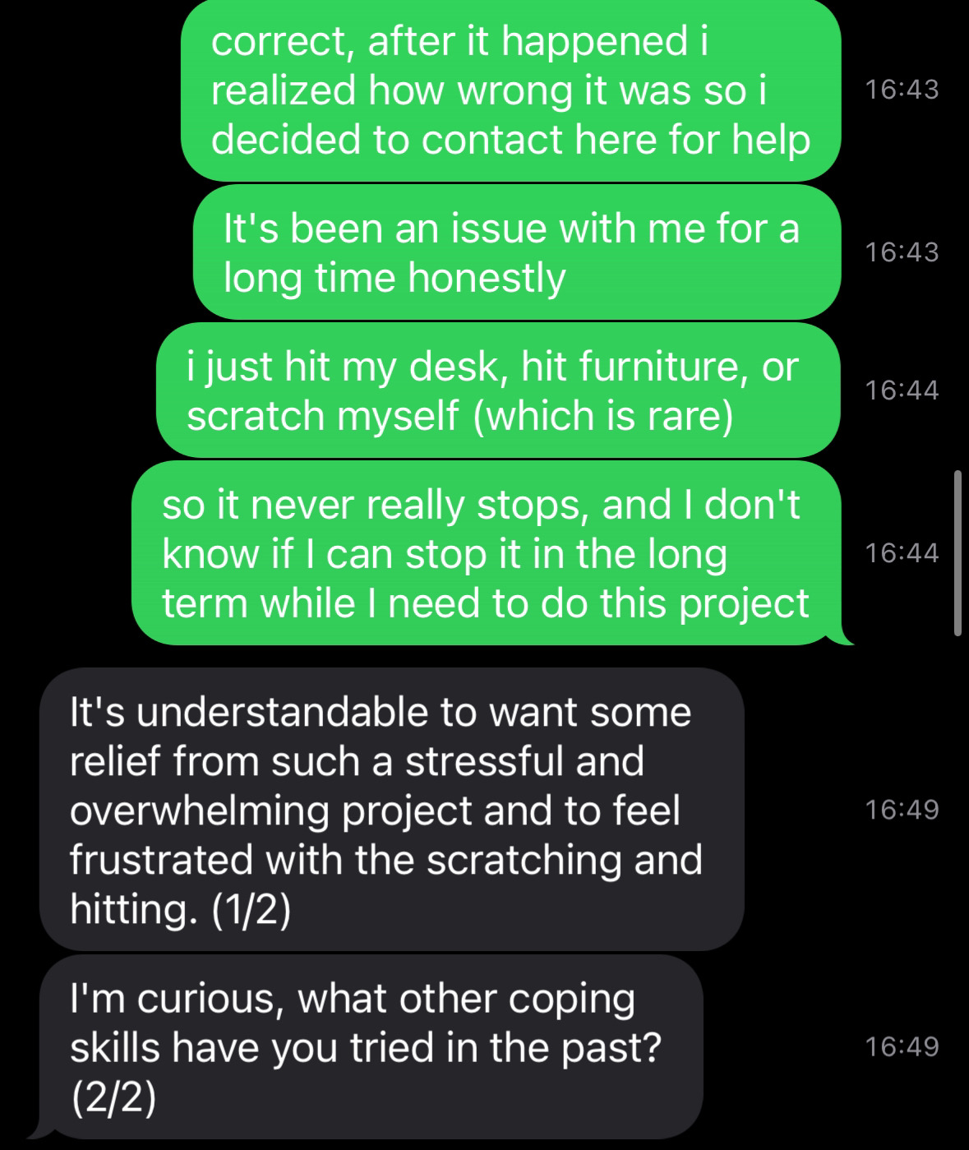
Ekin’s Experience

Slide 4
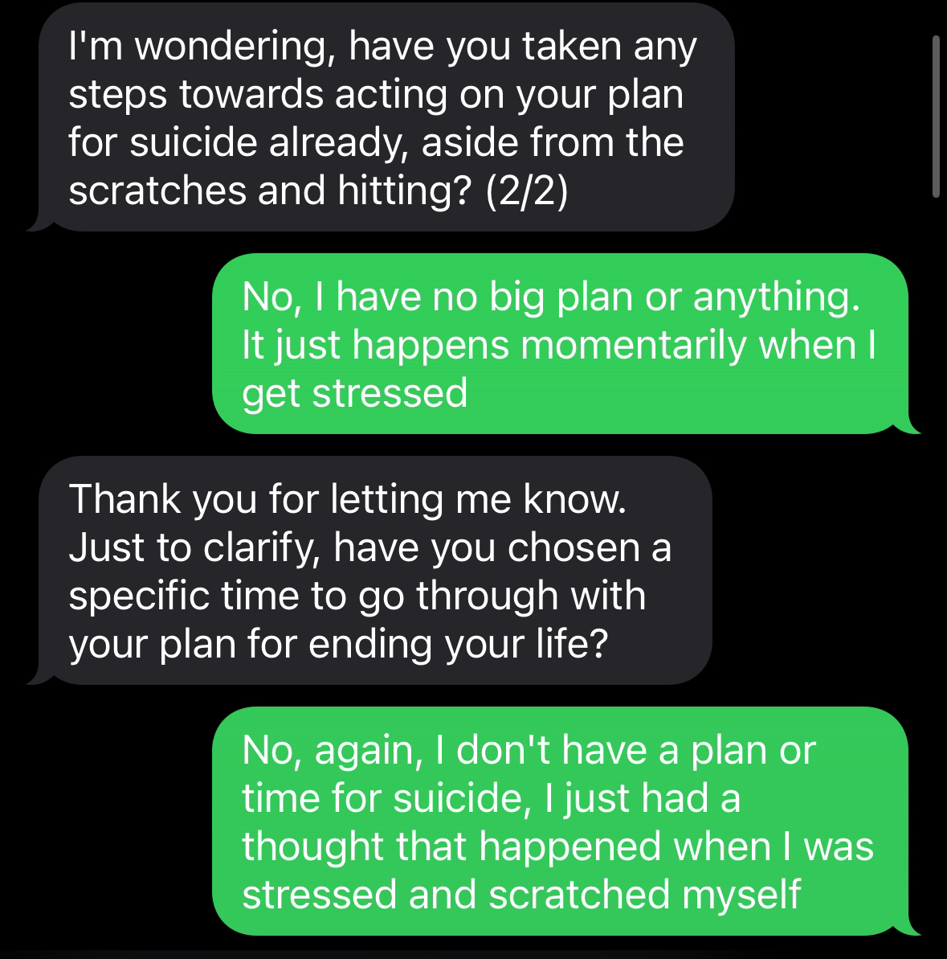
Ekin’s Experience

Slide 5
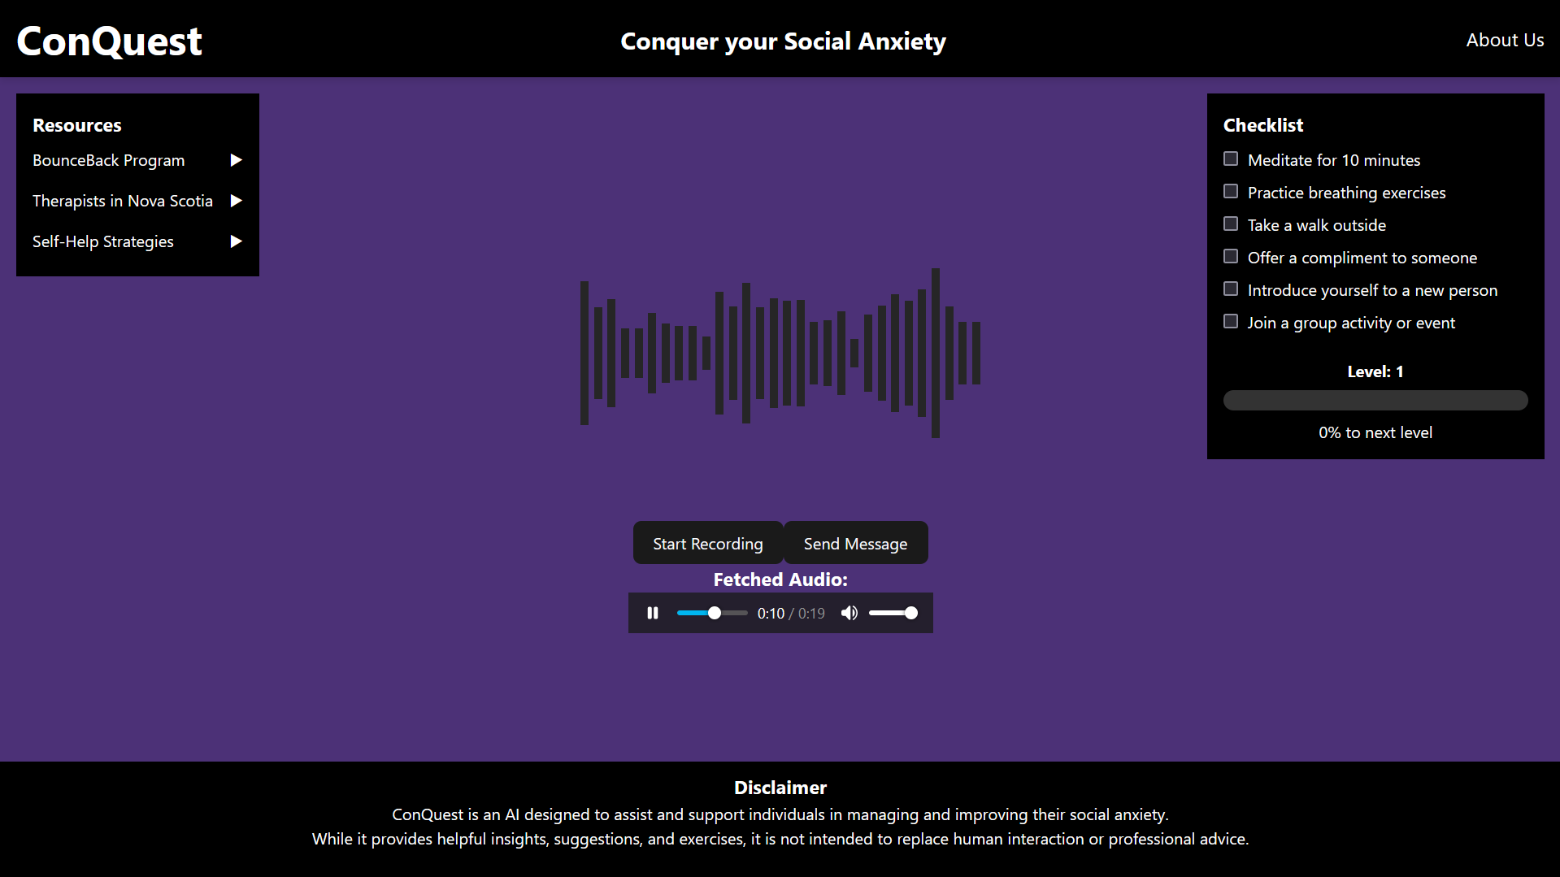
Our Product
Speech-To-Speech AI Model.
Bring back the voice conversation.
Keeps context of the topics.
Able to talk from many contexts of
work, academics, social interactions.

Slide 6

Where From Here:
User profiles, display levels, achievements

Slide 7

Where From Here:
Optimize message retrieval

Slide 8

Where From Here:
Talk by phone!

Slide 9
Thank you for listening

Slide 10
Q&A

